Slide 1
Chapter 15 – Skin Tissue Engineering and Keratinocyte Stem Cell Therapy

Slide 2
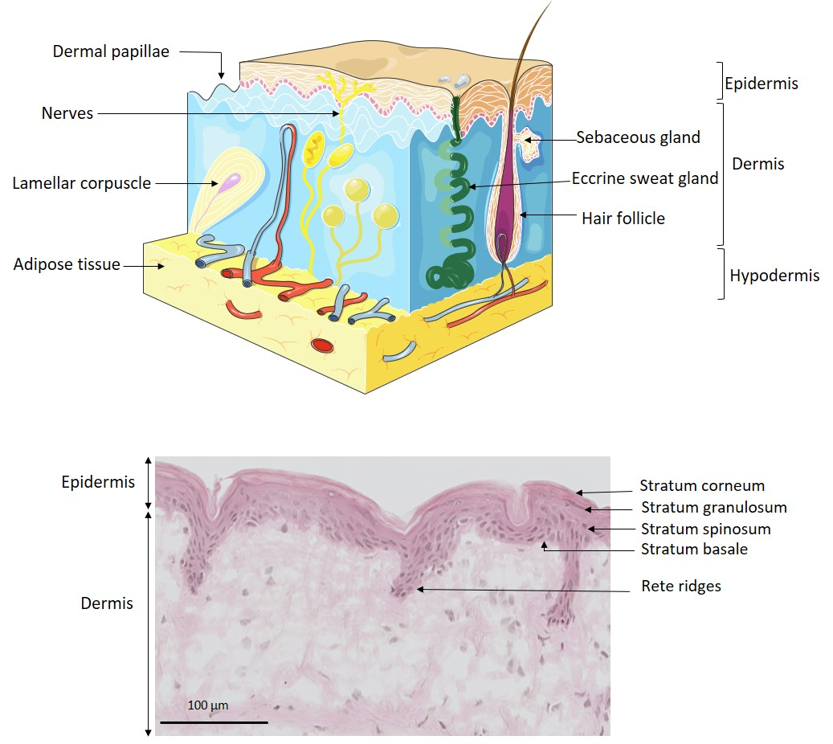
Notes:
Figure 15.1: a) Schematic of normal skin structure, components and layers. b) Histological image of dermis/epidermis.
Adapted from Servier Medical Art, Creative Commons Attribution 3.0 France.

Slide 3
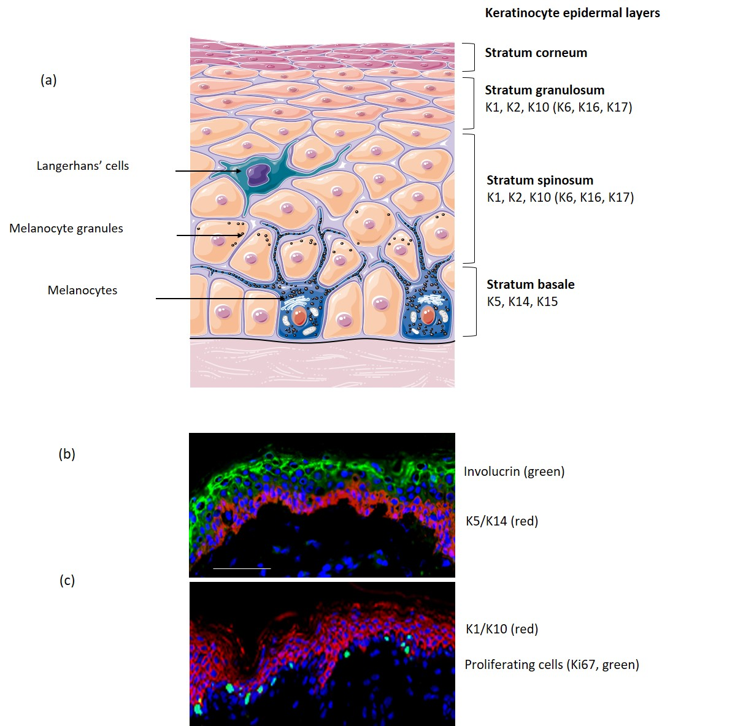
Notes:
Figure 15.2: Schematic arrangement of keratins (a) and cell proliferation markers in the different epidermal layers (b-c).
From Servier Medical Art, Creative Commons Attribution 3.0 France

Slide 4
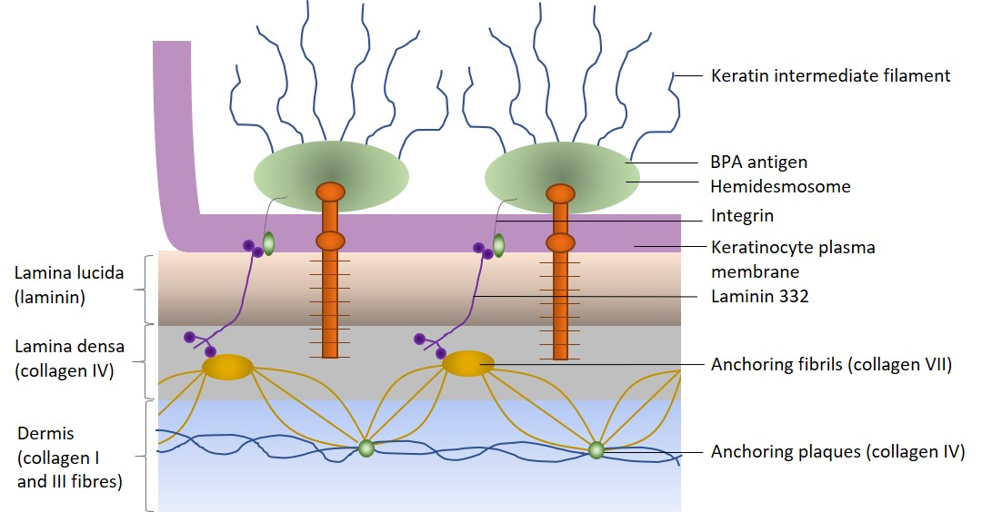
Notes:
Figure 15.3: The dermo-epidermal junction.

Slide 5
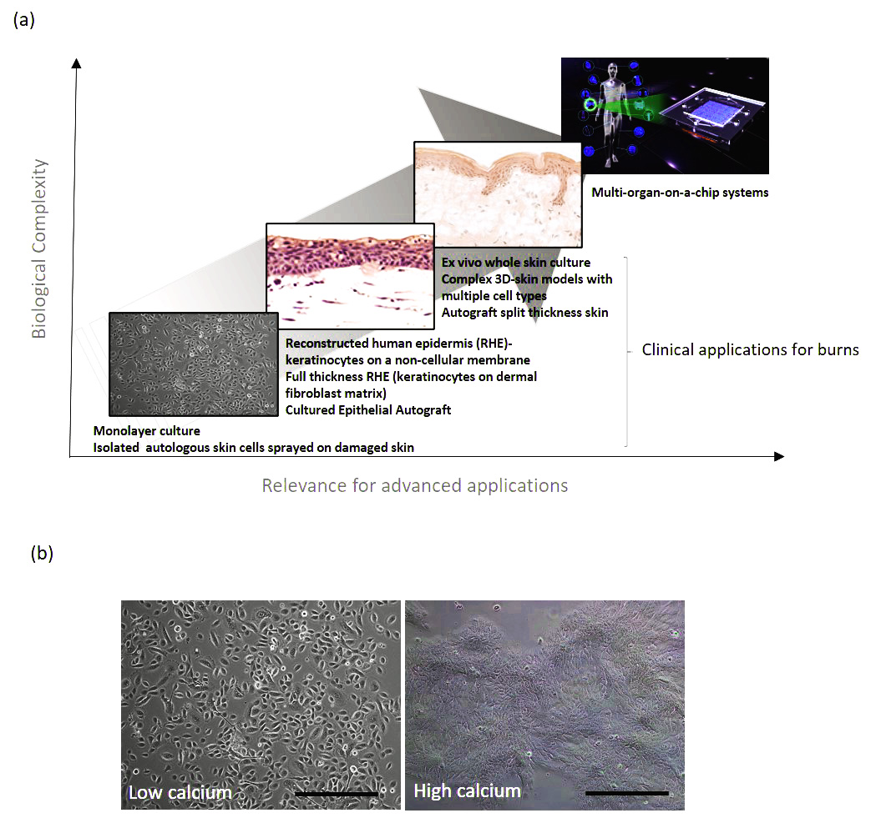
Notes:
Figure 15.4: Advances in keratinocytes culture, enabling applications in patient care. Scale bar = 200 µm.

Slide 6
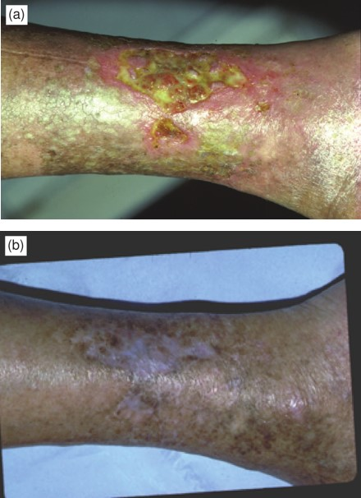
Notes:
Figure 15.5: Cultured keratinocyte grafts used to cover a leg ulcer before (a) and after 3 weeks (b).

Slide 7
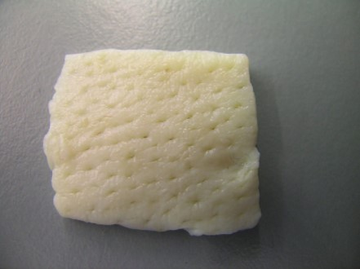
Notes:
Figure 15.6: Glycerol-preserved cadaveric skin used for preparing DED. A 1.5 × 1.5 cm square of DED is shown.

Slide 8
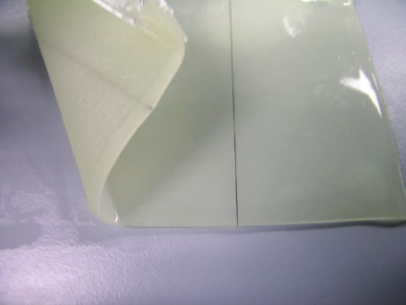
Notes:
Figure 15.7: Integra® with the silicone upper layer in situ. A 10 cm × 12.5 cm of Integra sheet is shown.
From ‘The development of novel dermal matrices for cutaneous wound repair’. Drug Discovery Today: Therapeutic Strategies, 3(1): 81–86. (Anthony, Syed et al. 2006).

Slide 9

Notes:
Figure 15.8: Commercially available product “Dermagraft®.
From Advanced Biohealing.

Slide 10
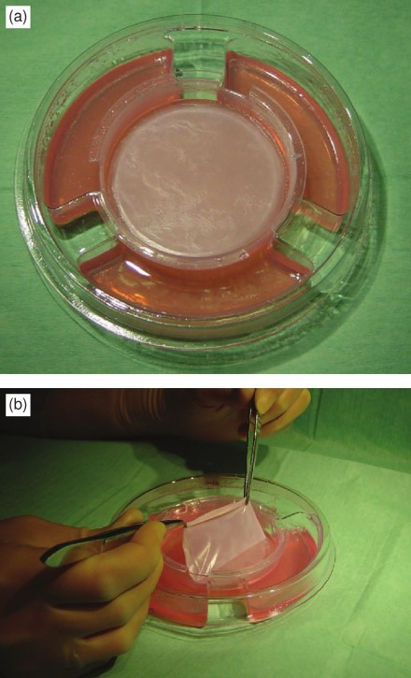
Notes:
Figure 15.9: a) Apligraf® in Transwell. b) Apligraf® being freed from agarose media prior to clinical application.

Slide 11
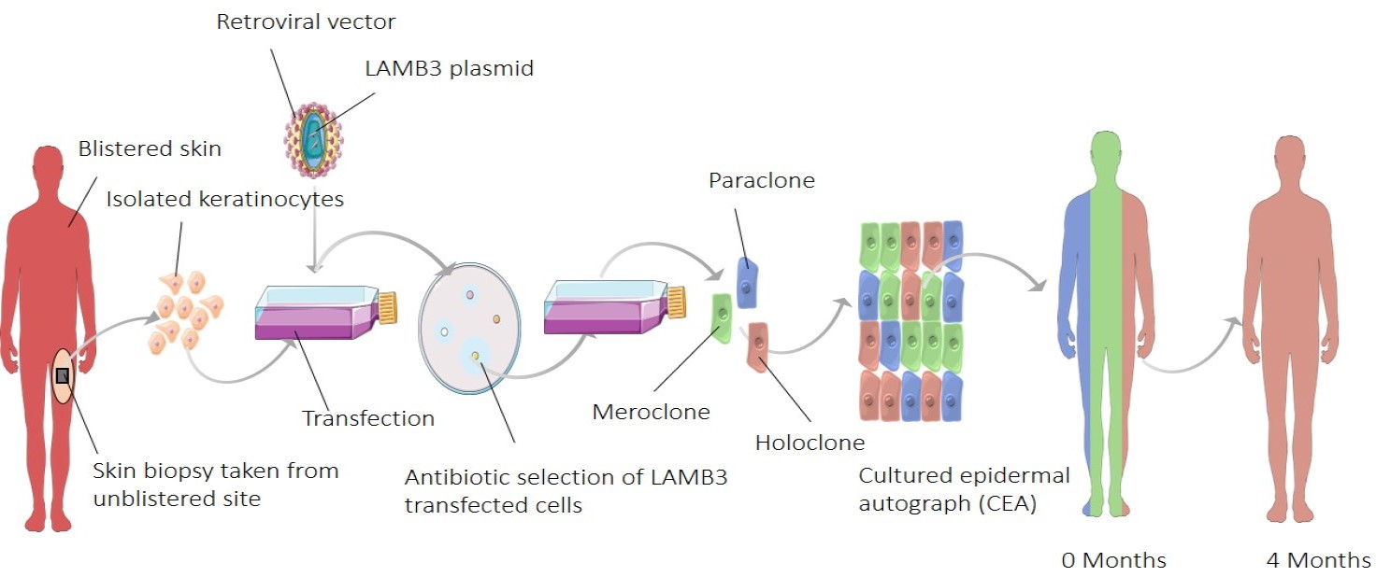
Notes:
Figure 15.10: Skin tissue engineering creating a genetically modified cultured epidermal autograph to treat a 7-year-old child with junctional epidermolysis bullosa.
Adapted from Servier Medical Art, Creative Commons Attribution 3.0 France.

Slide 12
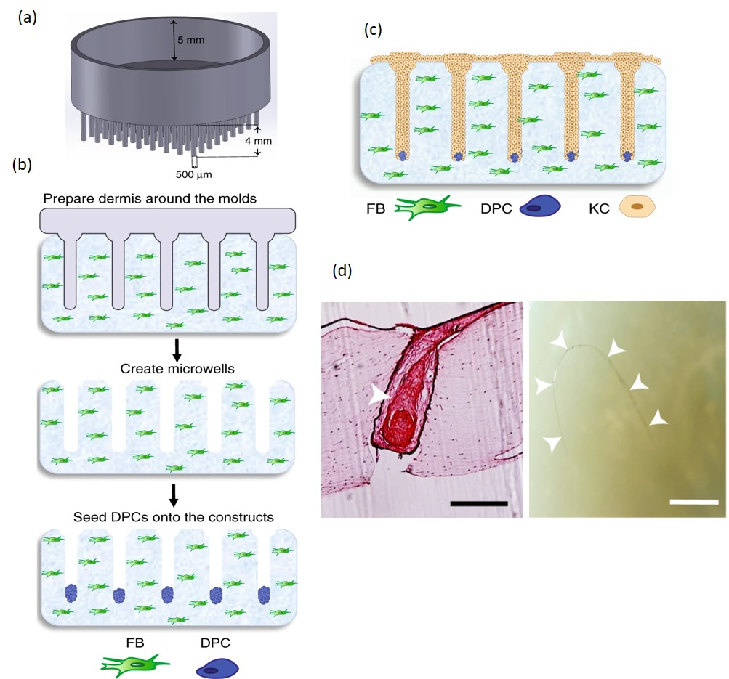
Notes:
Figure 15.11: 3D skin model with engineered functional hair follicles made entirely from cultured cells. a) Hair follicle mold. b) Fibroblasts (FB) and dermal papilla cells (DPC) seeded into constructs. c) Keratinocytes (KC) seeded on top of construct. d) Mature hair produced in construct.
Adapted from ‘Tissue engineering of human hair follicles using a biomimetic developmental approach”, by H. E. Abaci, A. Coffman, Y. Doucet, J. Chen, J. Jacków, E. Wang, Z. Guo, J. U. Shin, C. A. Jahoda and A. M. Christiano, 2018, Nature communications, 9(1), 5301. https://doi.org/10.1038/s41467-018-07579-y. Copyright 2018 by Creative Commons Attribution 4.0 International License.

